Slide 1
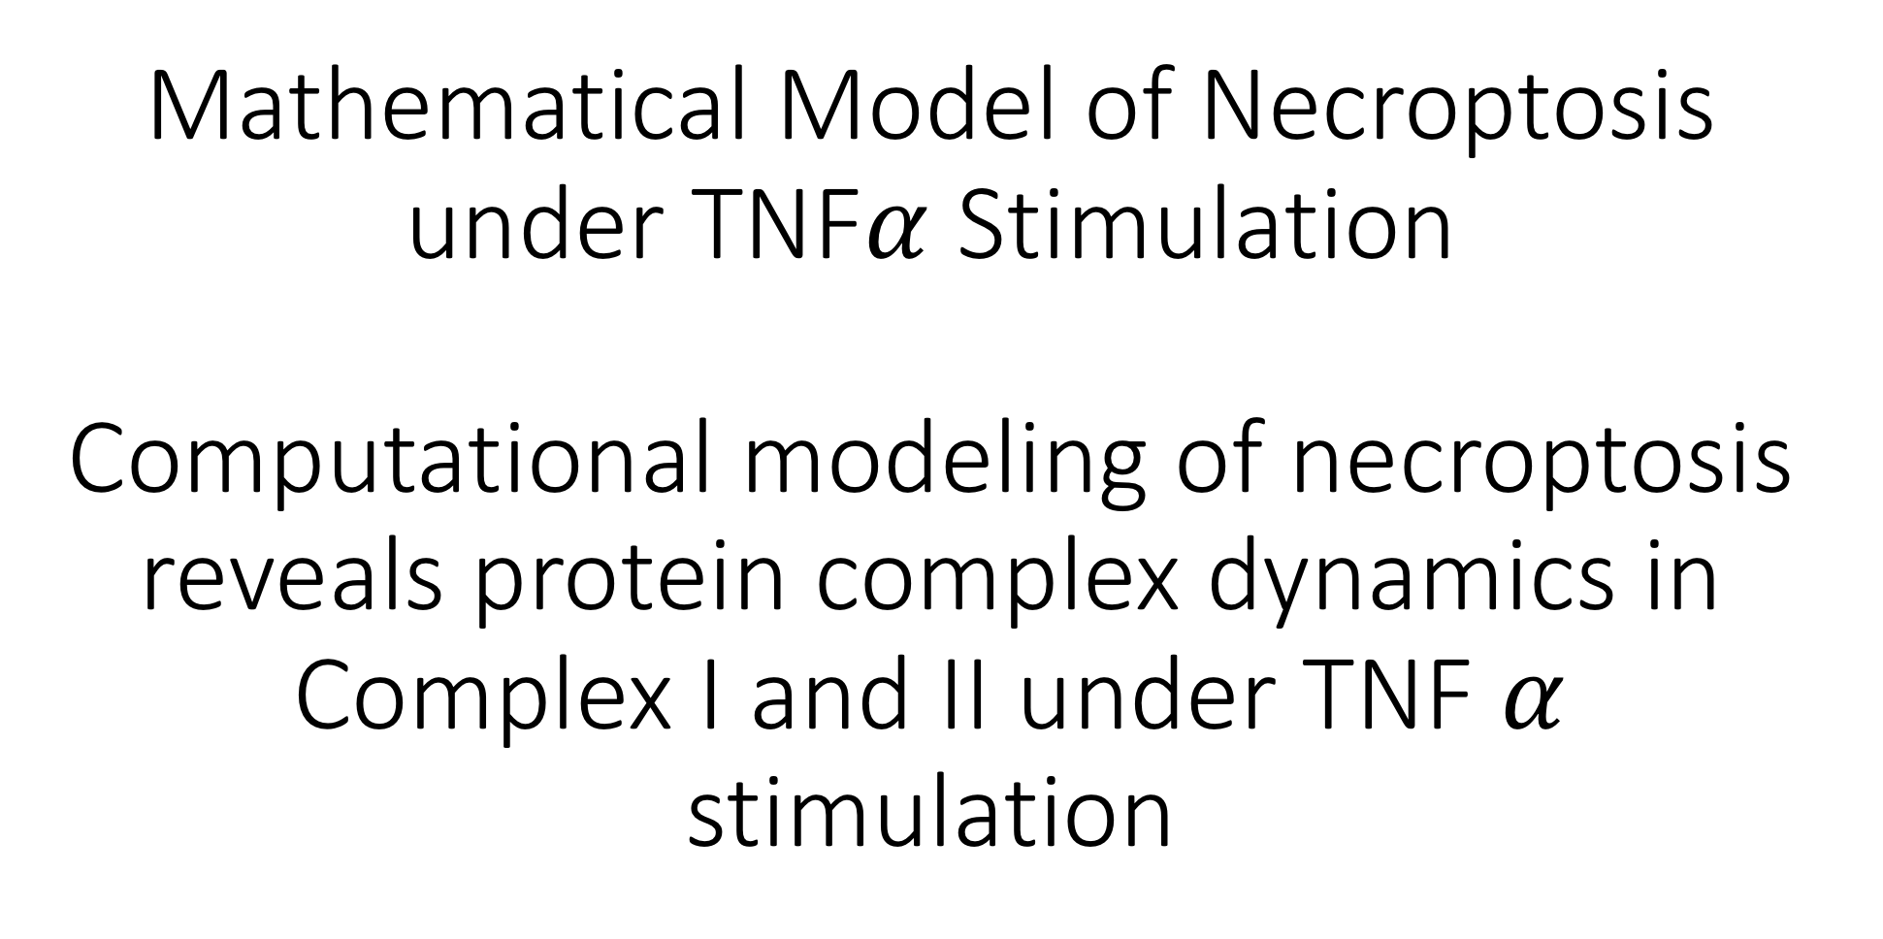
Mathematical Model of Necroptosis under TNF$α$ Stimulation Computational modeling of necroptosis reveals protein complex dynamics in Complex I and II under TNF $α$ stimulation

Slide 2
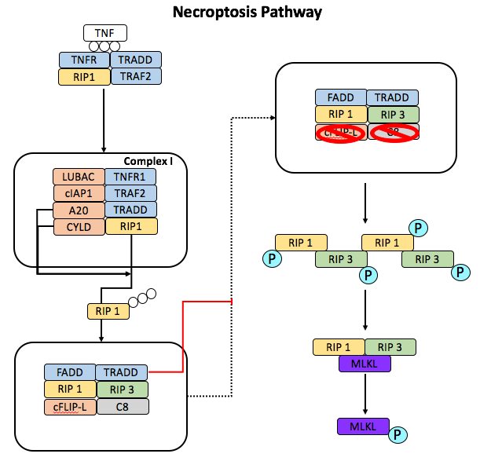
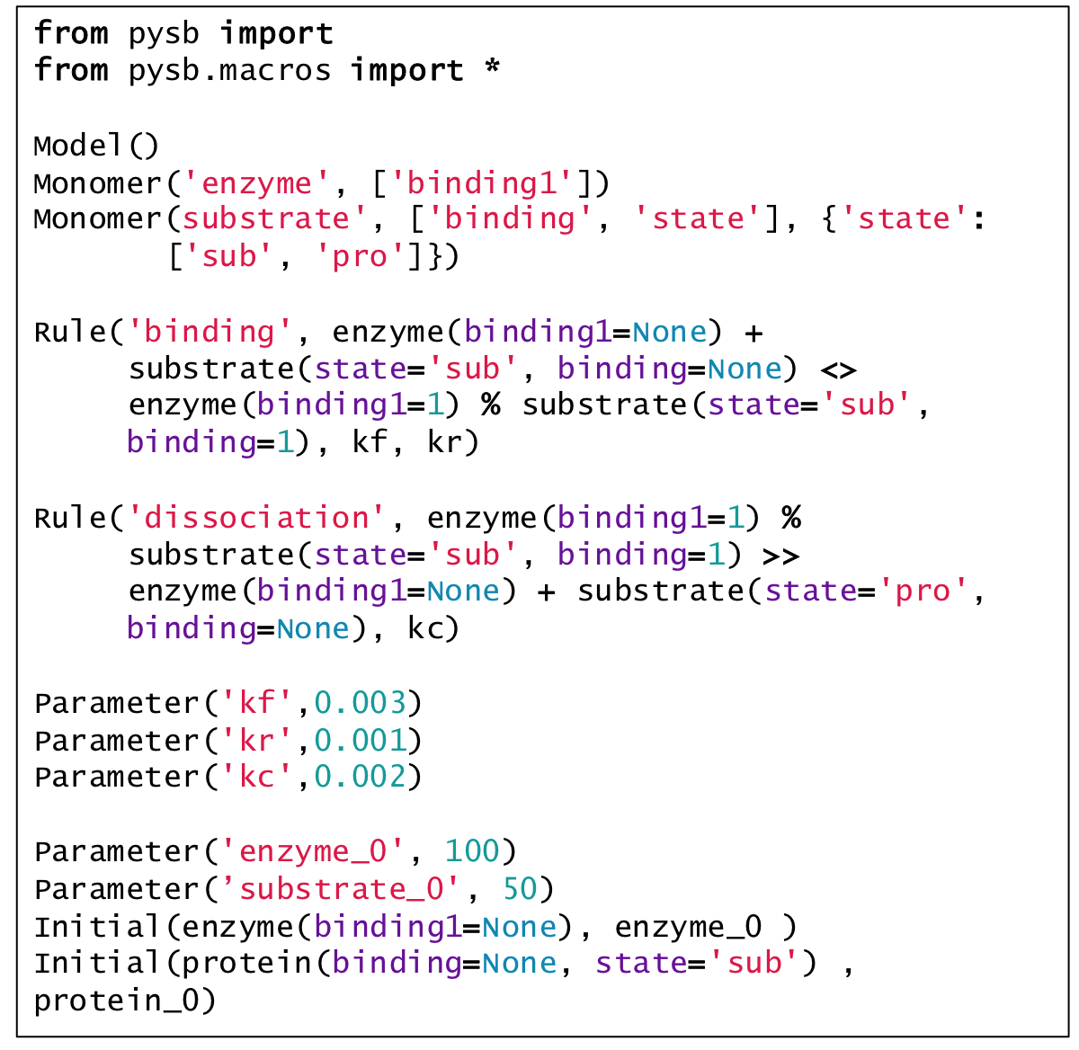
A.
B.
Figure 1: Network diagram of necroptosis pathway by TNFα stimulation.
Notes:
Model Parameters: 53
Model Rules: 36
Model Odes/Species: 39

Slide 3
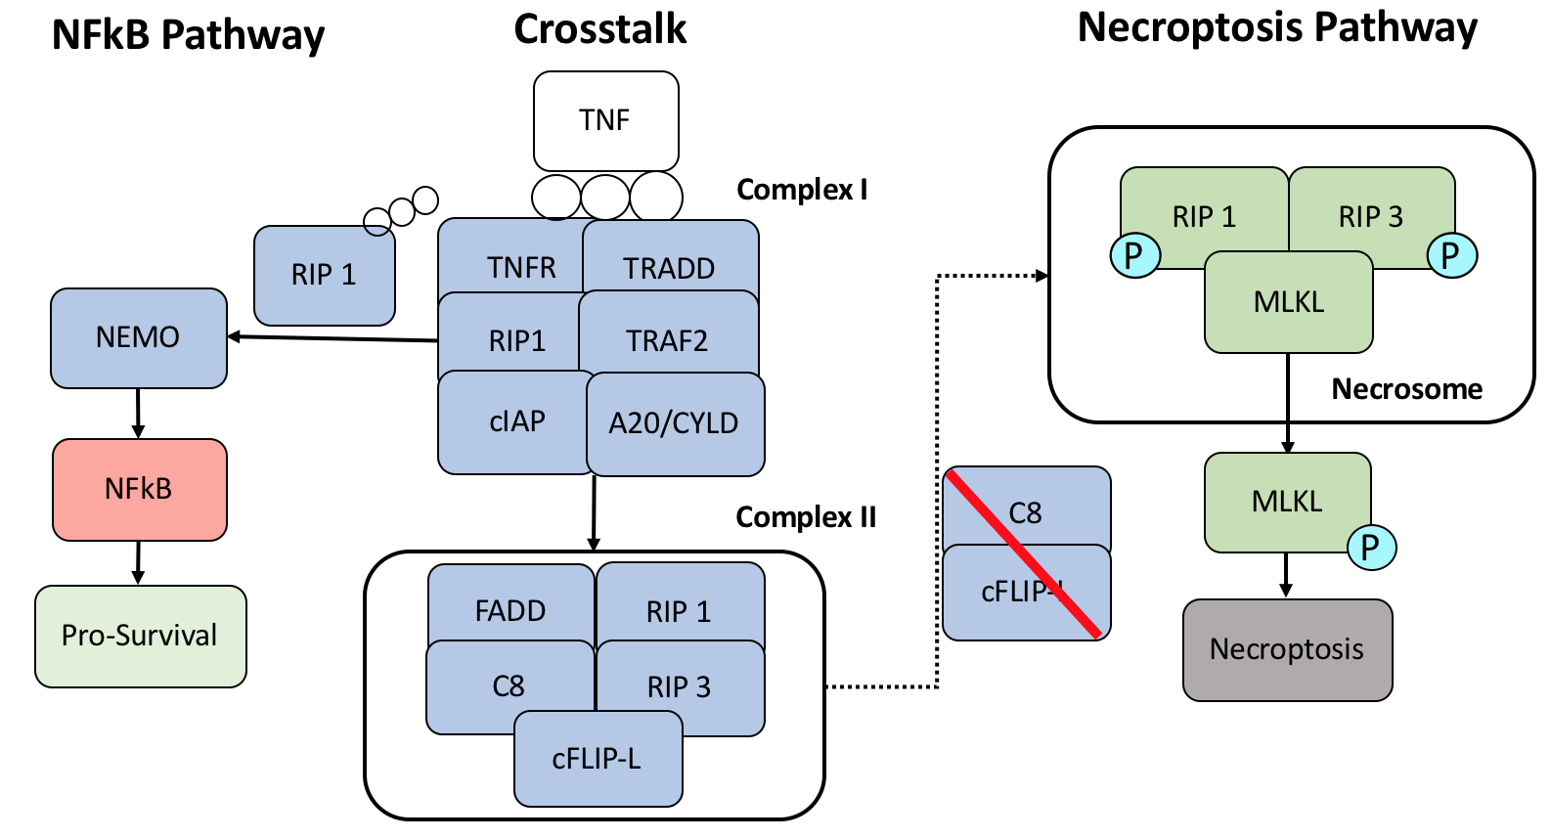
A.
B.
Figure 1: Network diagram of necroptosis pathway by TNFα stimulation.
Notes:
Model Parameters: 53
Model Rules: 36
Model Odes/Species: 39

Slide 4
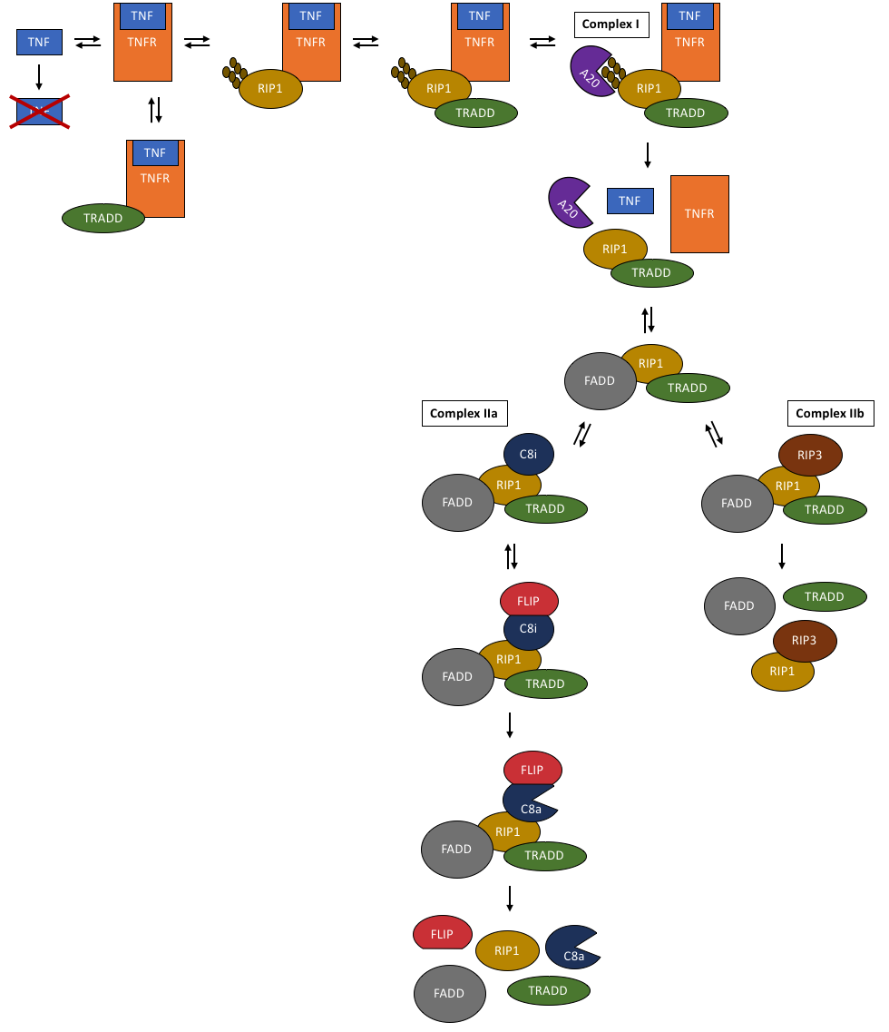
A.
B.
Figure 1: Network diagram of necroptosis pathway by TNFα stimulation and PySB modeling framework.
Notes:
Model Parameters: 53
Model Rules: 36
Model Odes/Species: 39

Slide 5
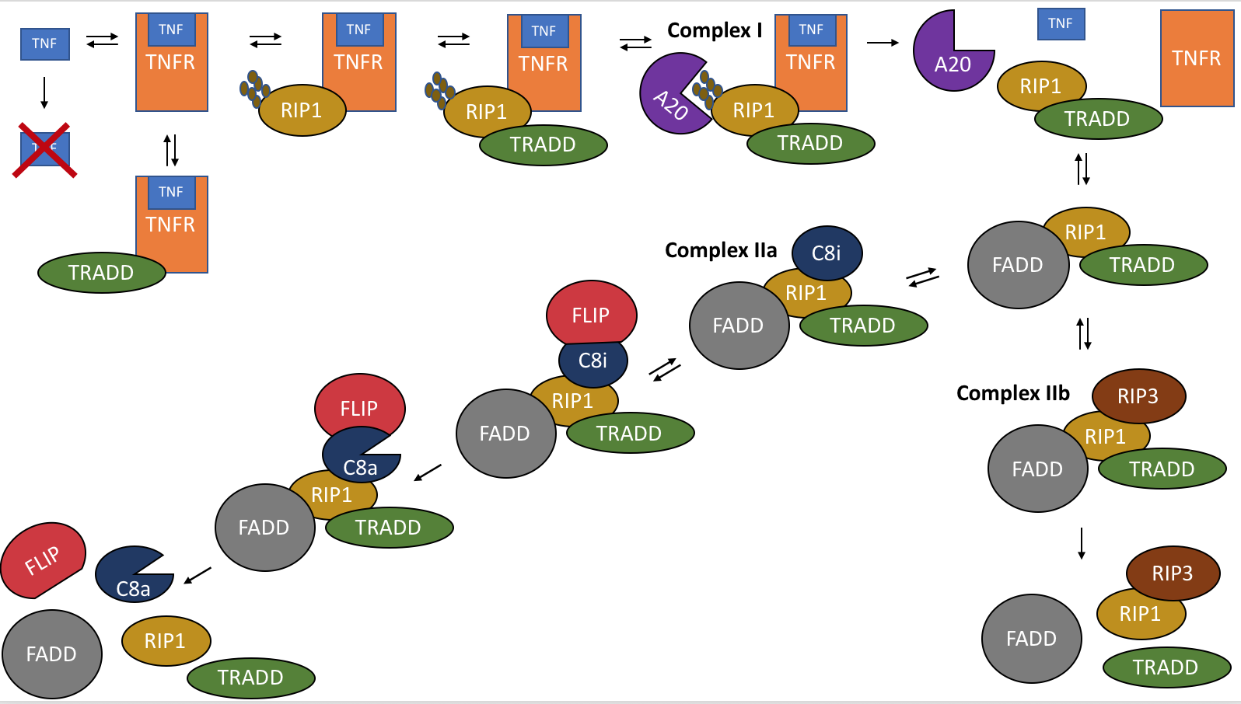
A.
B.
Figure 1: Network diagram of necroptosis pathway by TNFα stimulation and PySB modeling framework.
Notes:
Model Parameters: 53
Model Rules: 36
Model Odes/Species: 39

Slide 6
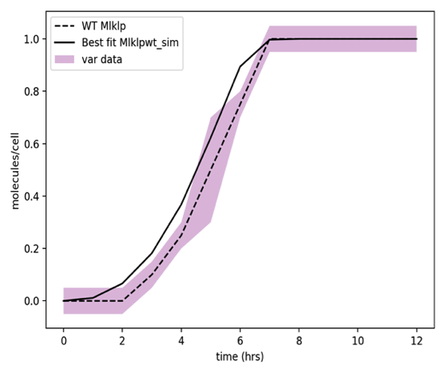
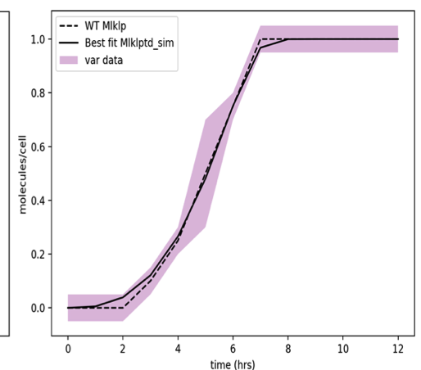
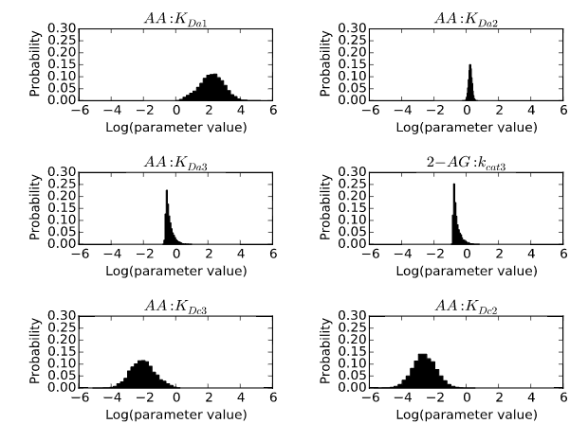
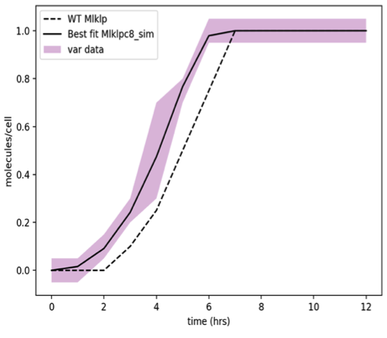
A.
B.
Figure 2: Calibration results .
Notes:
Calibrator: PSO
Iterations: 15,000
Particles: 50
Time to finish: ~2 days

Slide 7
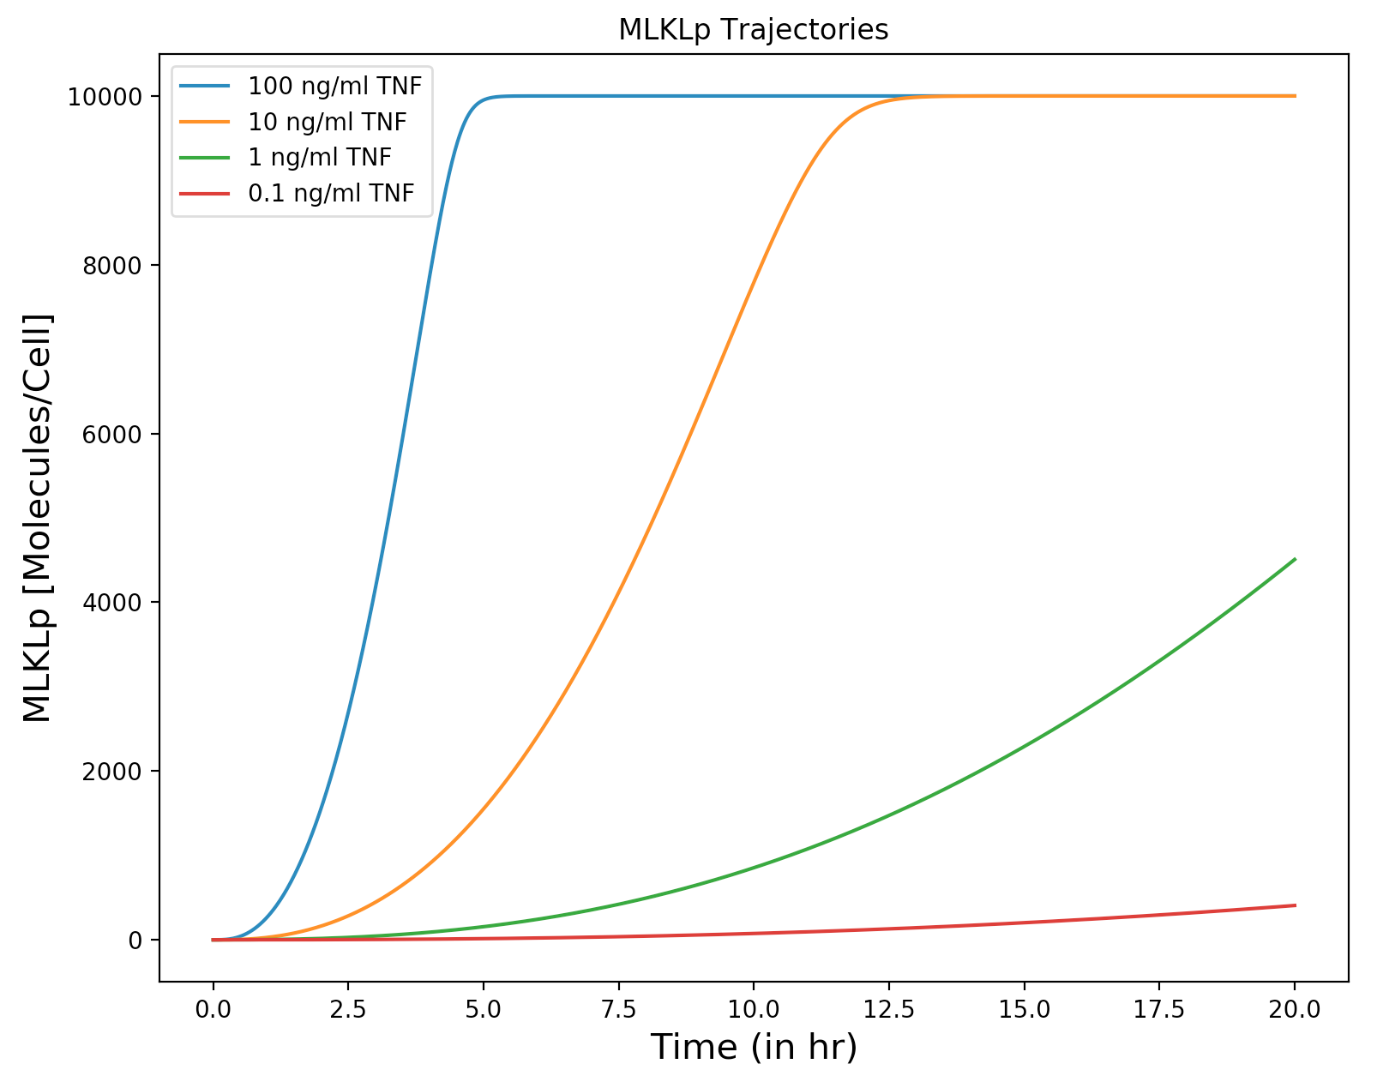
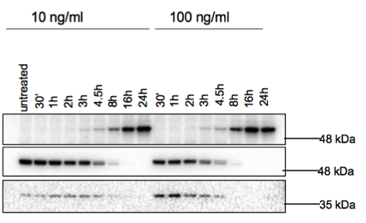
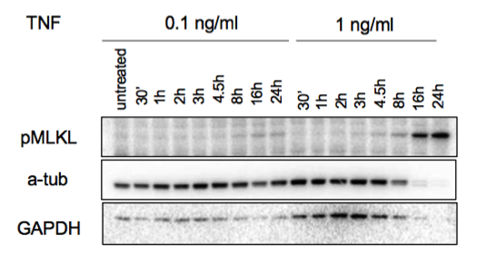
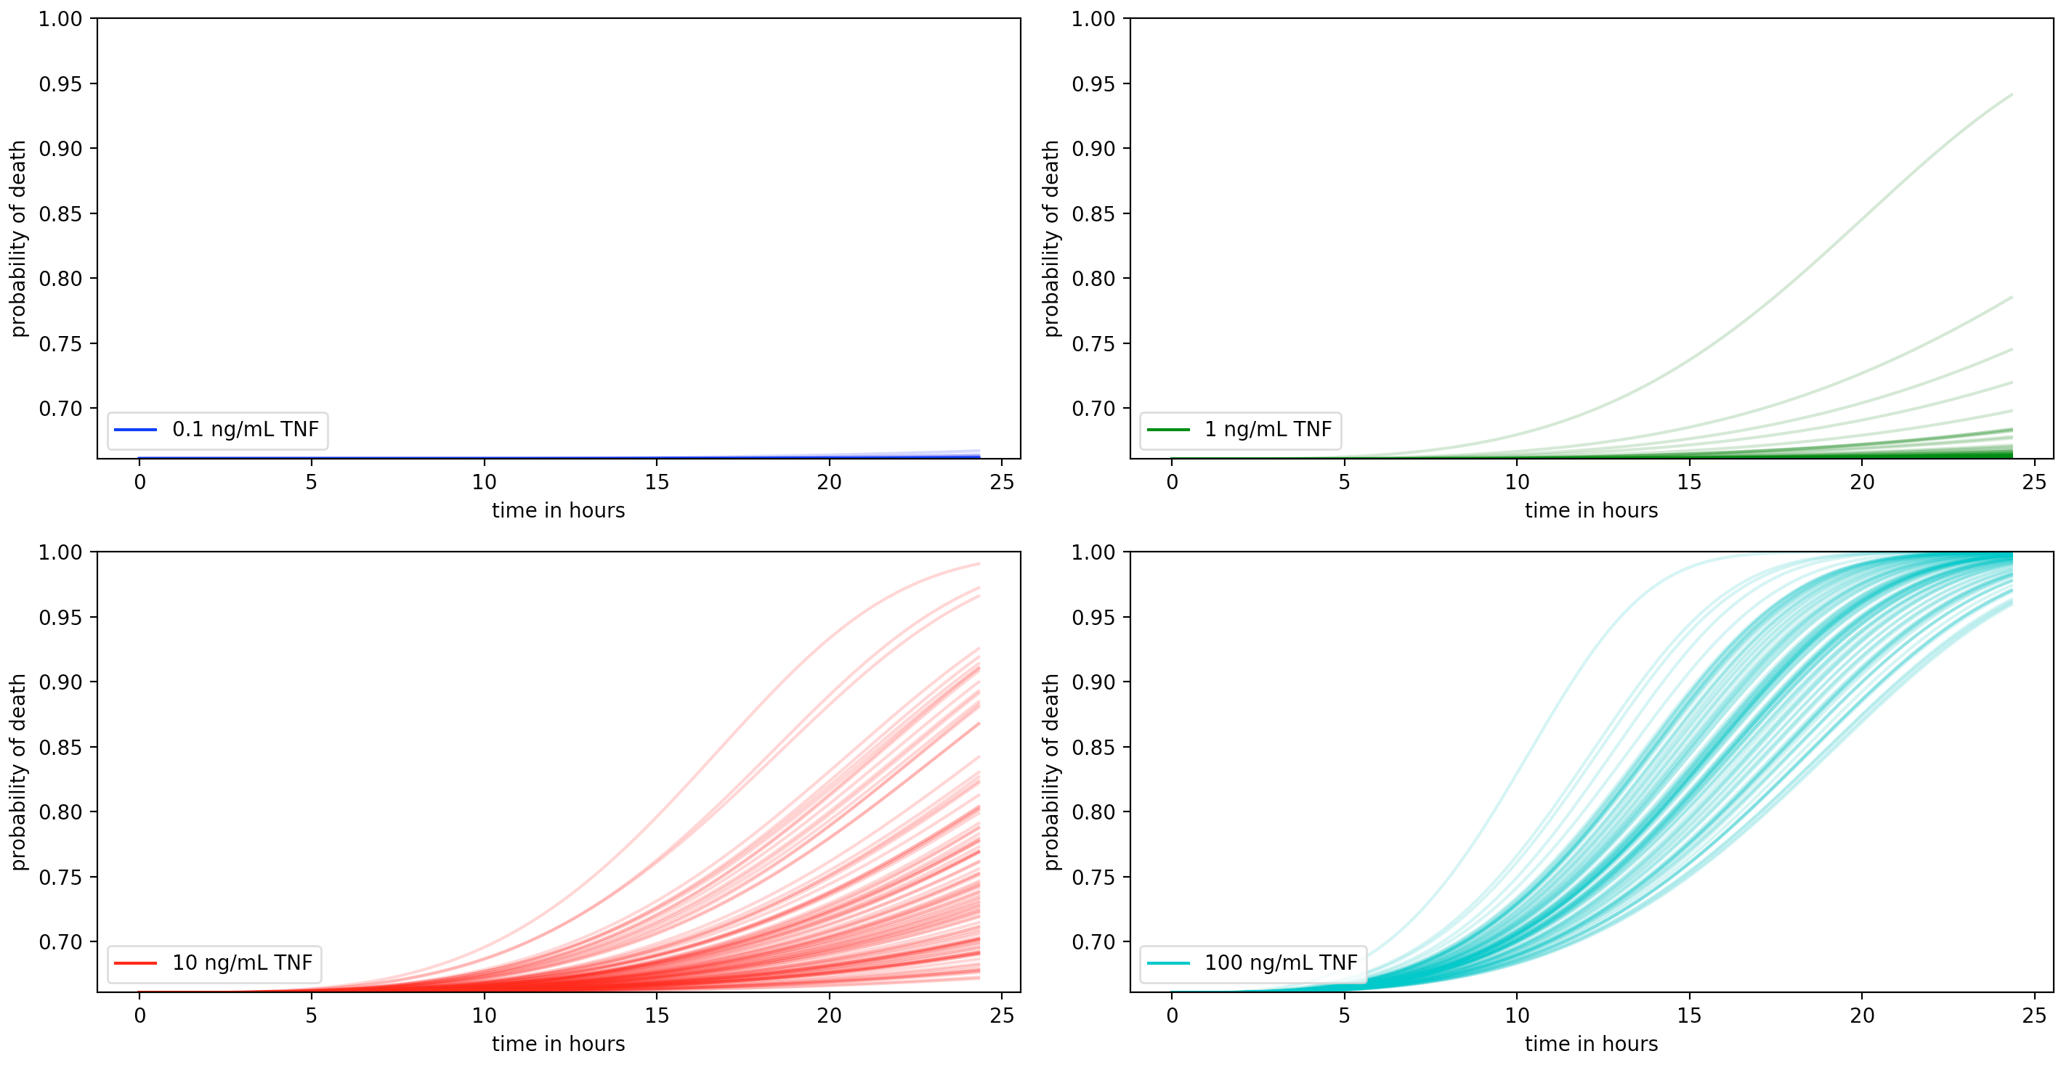
A.
B.
C.
D.
Figure 3

Slide 8
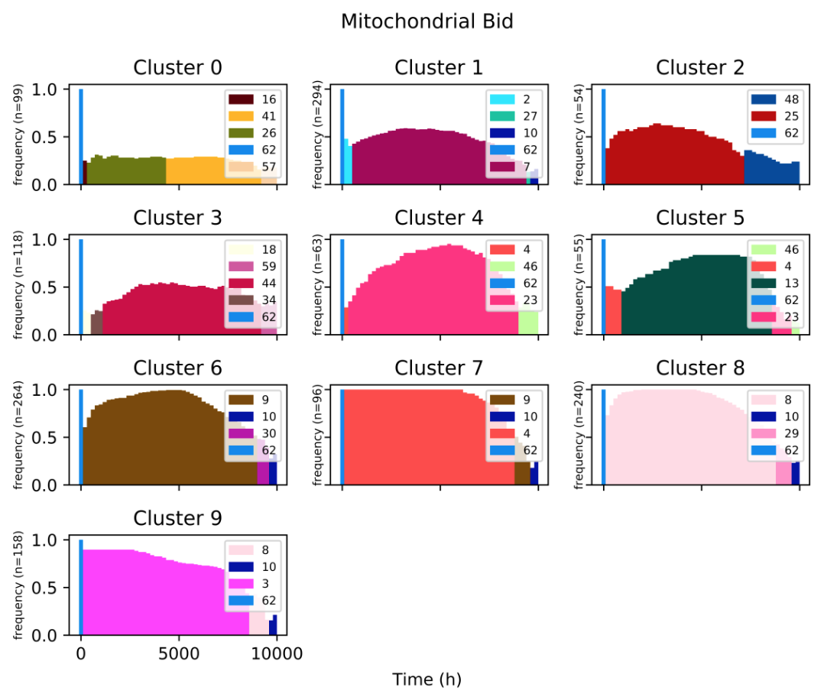
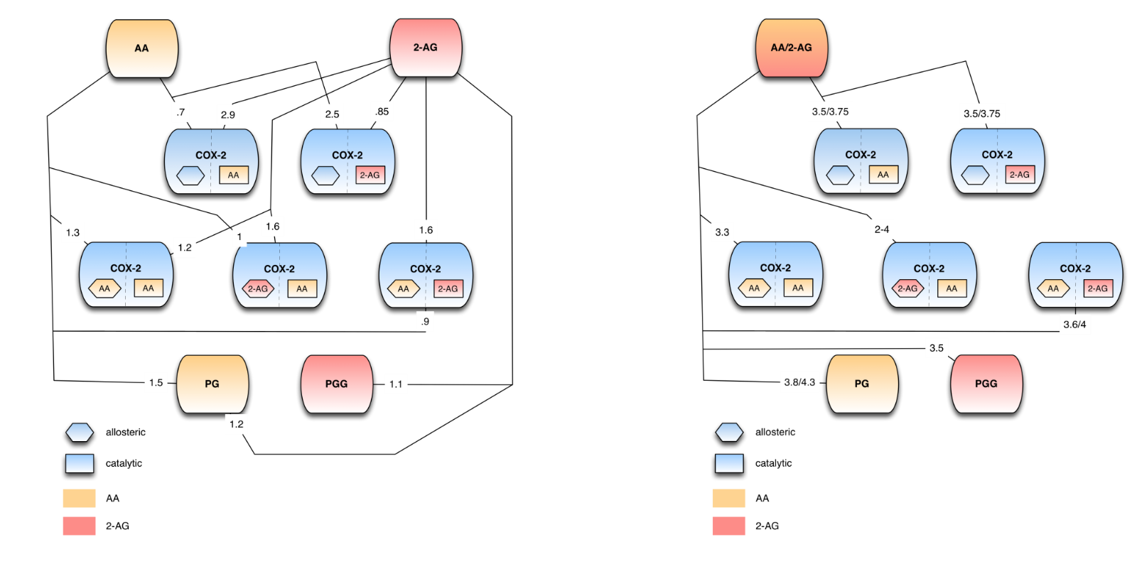
A.
B.
C.
Figure 4: Modes of execution in Complex I and II. A) Clustering analysis of Complex I. B,C) Information flow in network of Complex I and II.

Slide 9
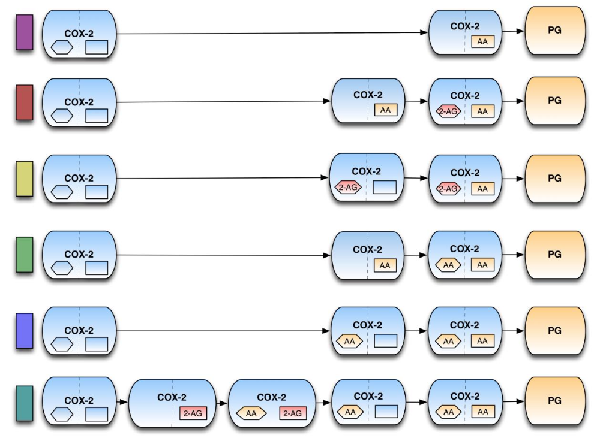
A.
B.
C.
Figure 4: Possible paths to Complex I and II execution.

Slide 10
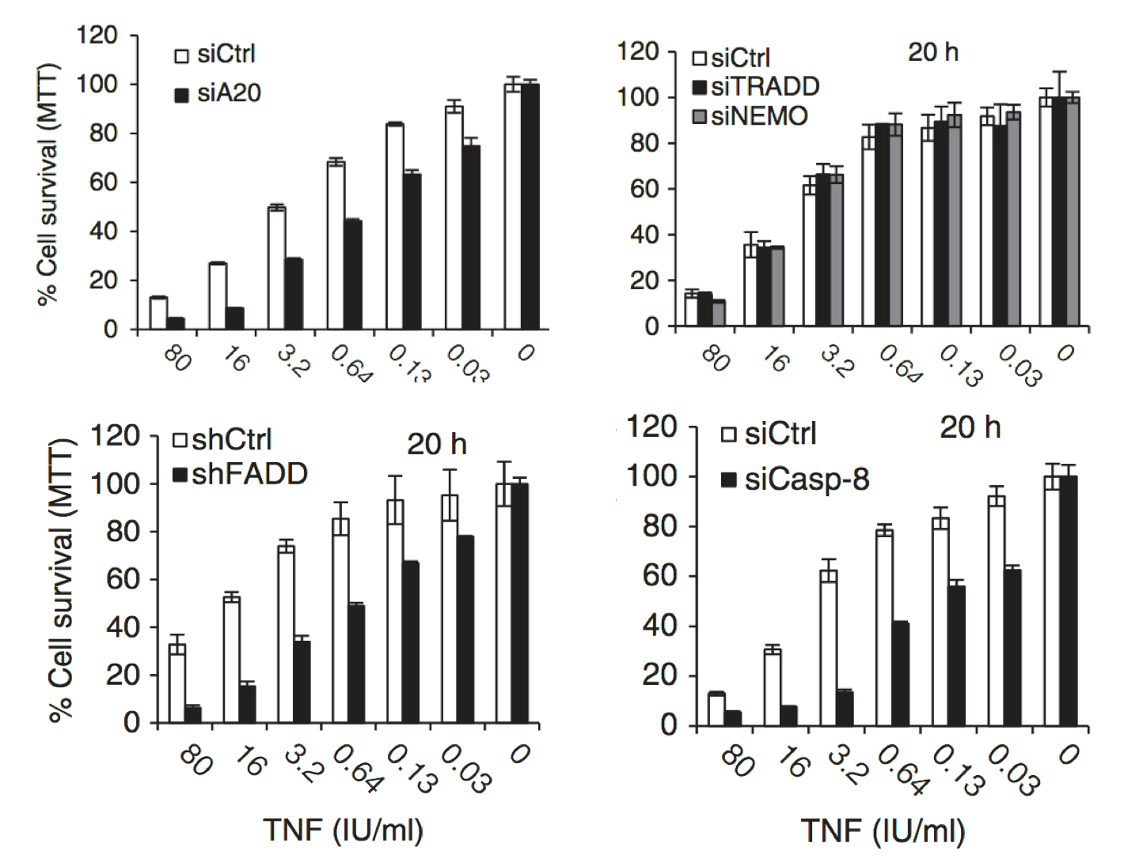
Possibly MS data? And in silico KD sims
Figure 5: In Silico Knockdowns.

Slide 11
Supplemental

Slide 12
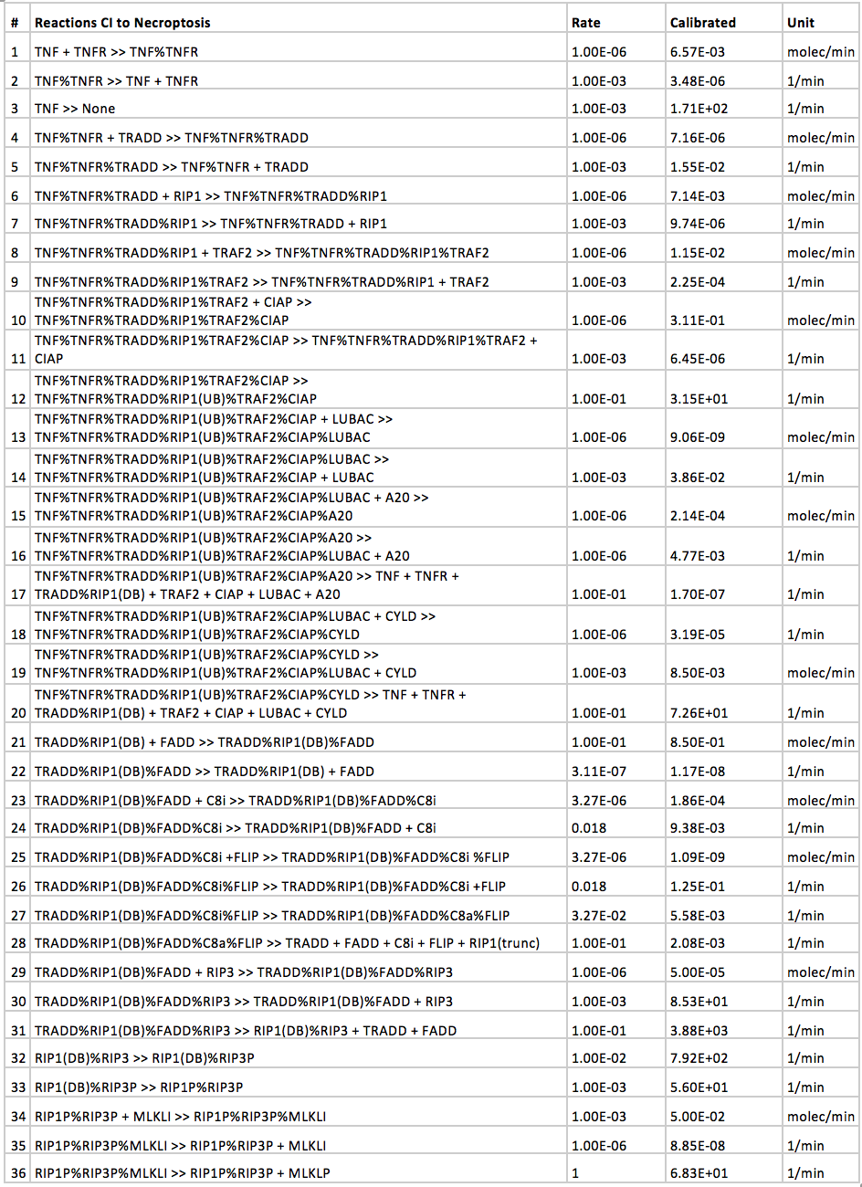
Add IC’s here in a table?
Supplemental Figure 1: Network diagram of necroptosis pathway by TNFα stimulation.

Slide 13
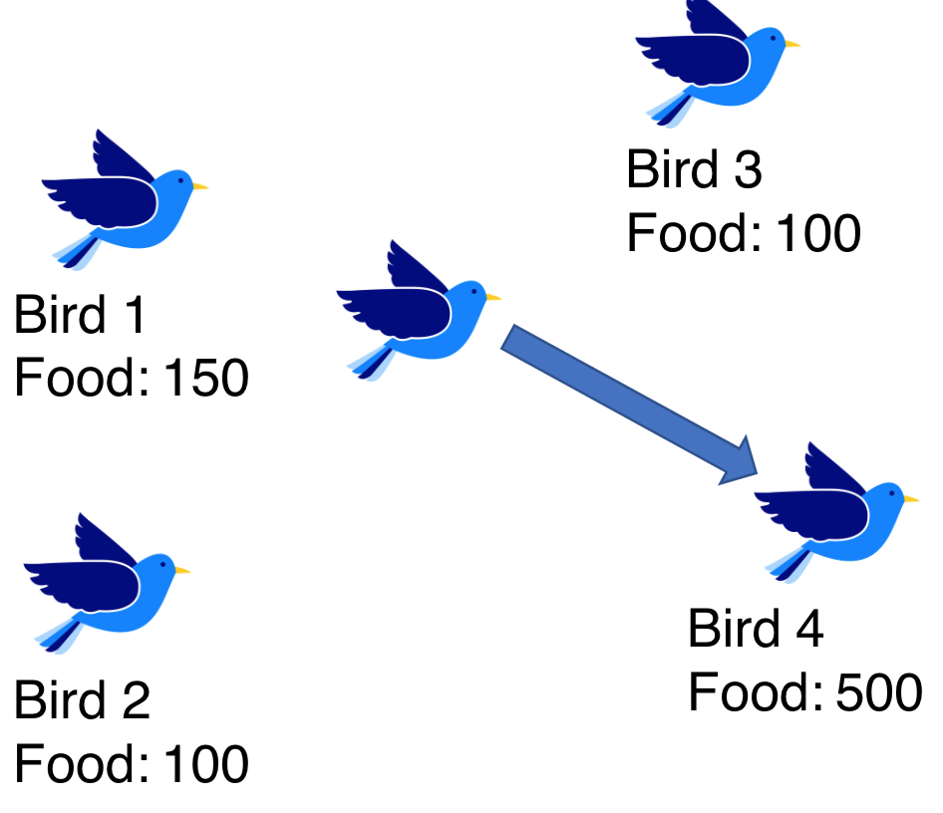
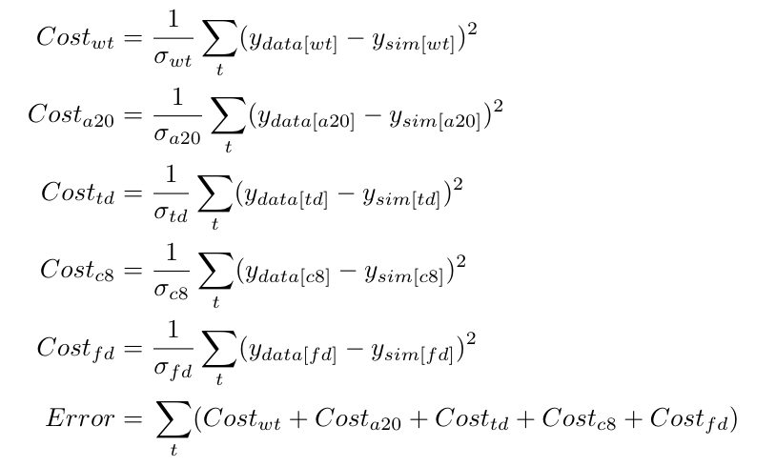
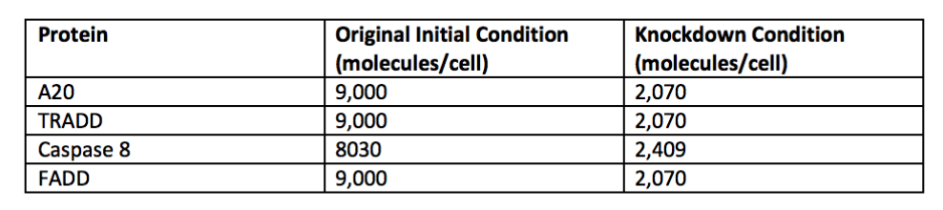
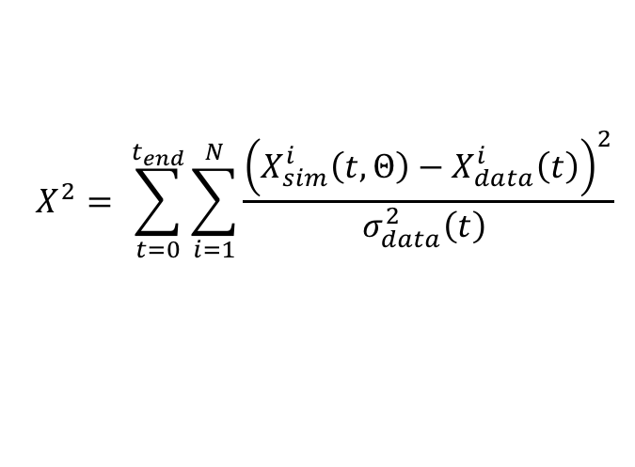
Particle Swarm Optimization
Objective Function:
Where should I go next?
$$X^{2}= \sum_{t=0}^{t_{end}}{\sum_{i=1}^{N}{\frac{{\left(X_{sim}^{i}\left(t, Θ\right)−X_{data}^{i}\left(t\right)\right)}^{2}}{σ_{data}^{2}\left(t\right) }}}$$
Objective Functions for Model:

Slide 14
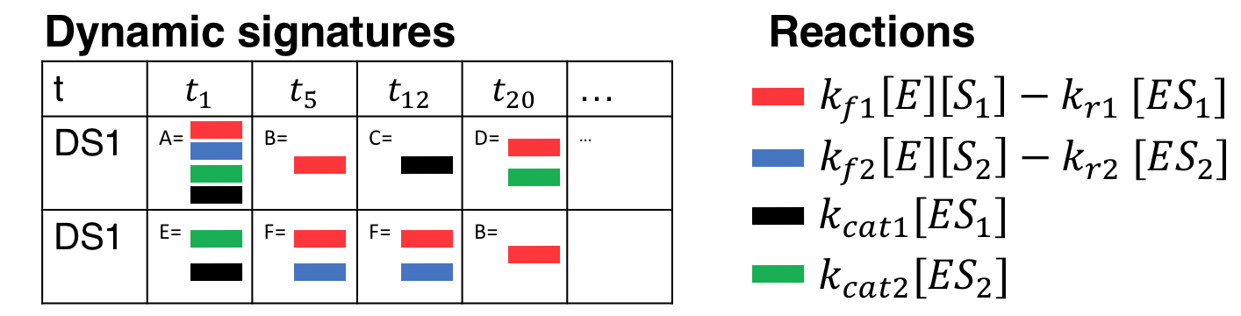
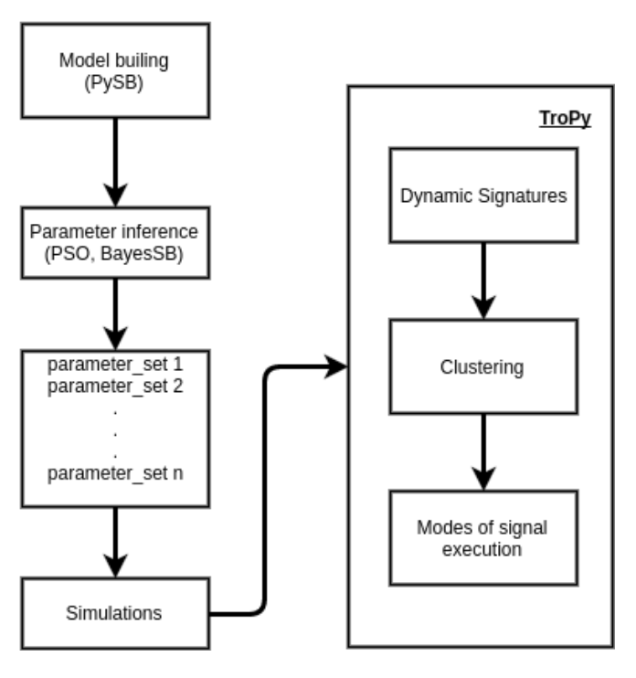
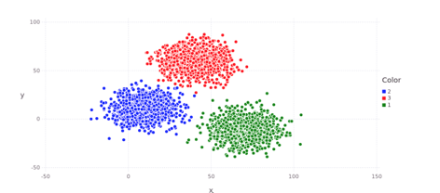
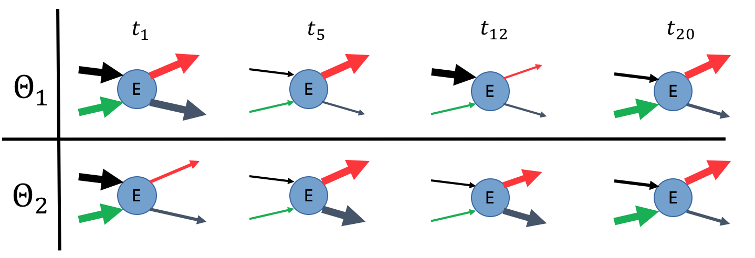
Determining Modes of Execution
TroPy: Oscar Ortega

Slide 15
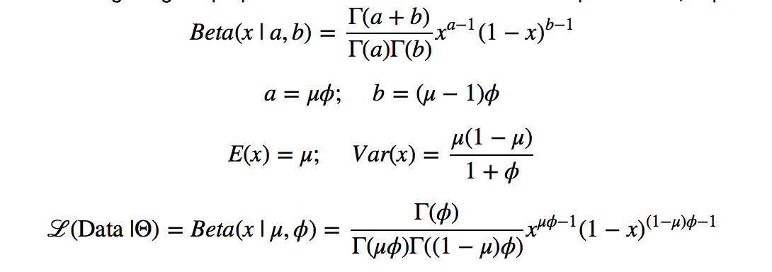
Calibration Algorithm
convergence
Simulate Experimental Conditions
$$X_{t=0}$$
Model the Dynamics
$$X(t)$$
Preprocessing &
Dimensionality Reduction
$$Θ_{rate}$$
$$Θ_{classification}$$
Generate New
Rate Parameters
Classification
Probabilistic Interpretation

Slide 16
L929 Data, Vanlangenakker et al.

Slide 17
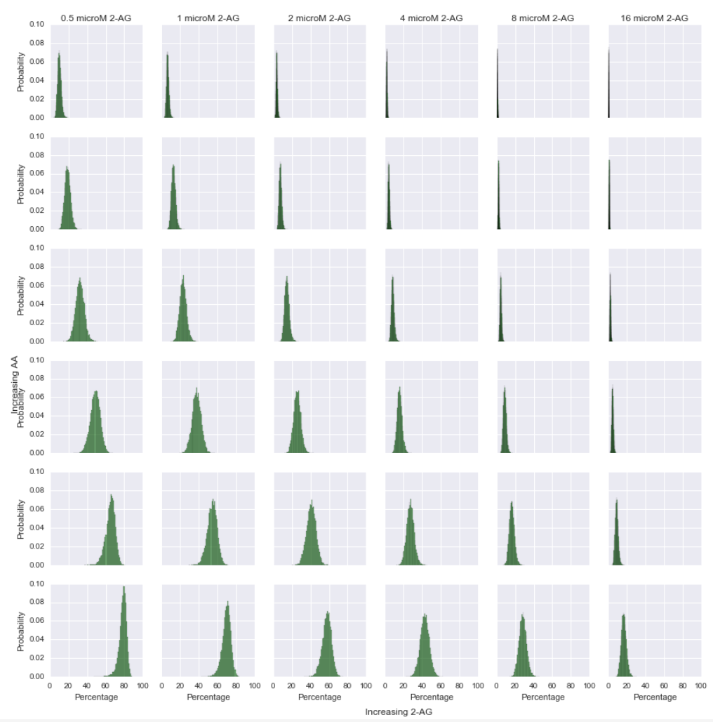
Distribution of parameters yields distribution of pathway fluxes

